Slide 1
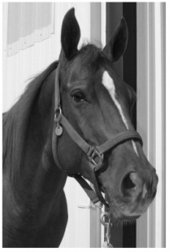

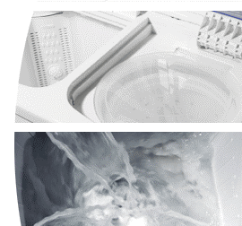
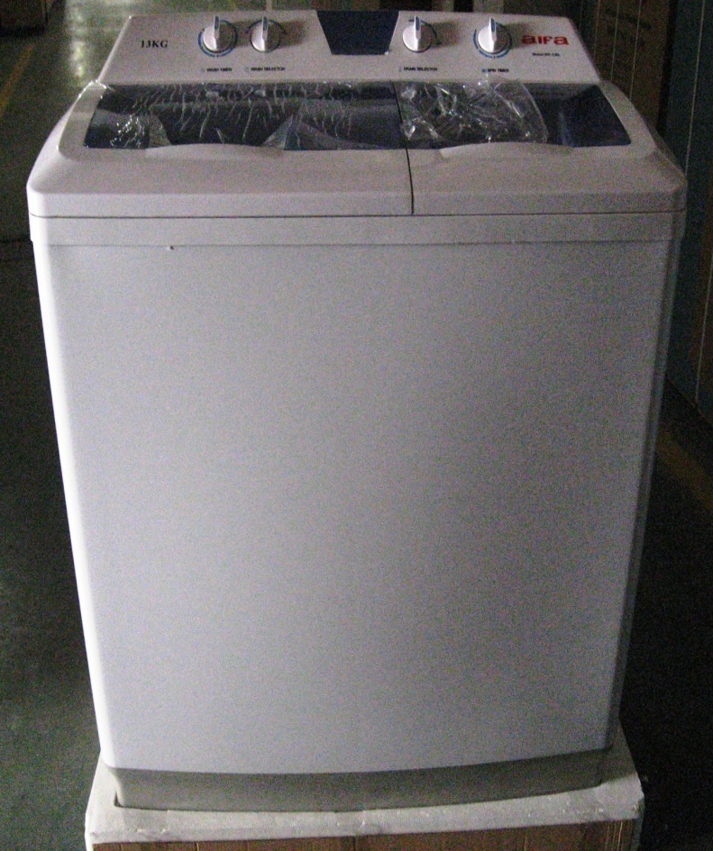
The 12kg MAG TX 12
Equine Horse Rug Washer & Hydro
Super large capacity load with a high spin extraction
Ideal for / saddle cloths / numnahs / turnout rugs up-to 6-5ft
Specifications: Economical
Easy to use/Simple controls
Large 12.8kg wash
Large spin drying capacity 8kg
Modern plastic body design
Rinsing function
Solid non rusting tough plastic construction
Will wash and rinse/spin at same time
Add washing at any time whilst in operation
Extremely Quiet operation even on spinning
See through wash lid with double safety lids on the spinner with
safety brake. Stops before you open inner lid
1380rpm spin speed
Carry handles built into sides
Top fill hose attaches to your tap for hot or cold water
Selectable water inlet into wash tub or spinner for rinsing
Six stream washing action with rotating two way spinning agitator
on the base of the wash tub. Creates a powerful whirlpool that reverses every few seconds driving water through your clothes and reduces tangling
Normal / Delicate wash selector
Lint filter to catch fluff off your clothes
Offer Price
£975.00+vat
The MAG TX 12 Twin Tub,
a new brand of semi automatic washing machines,
providing great washing results, from a traditional
Idea with a modern design and specification.
This twin tub requires no fixed plumbing,
it has a Massive 12kg wash and 8kg spin,
NEXT DAY DELIVERY AVALIBLE
01422 300589

